Slide 1
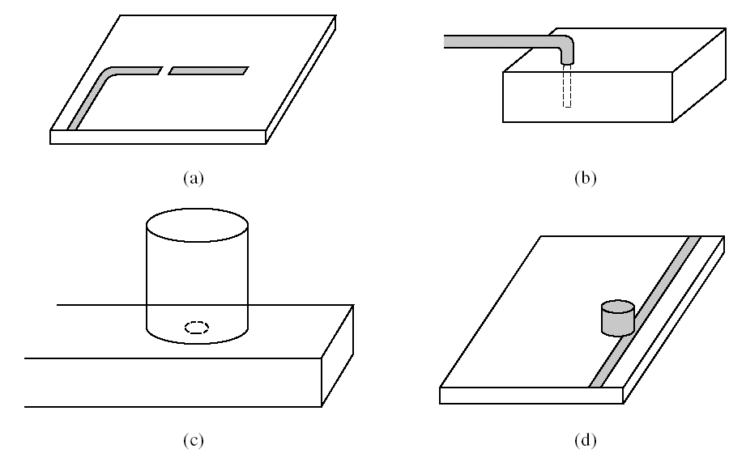
§6.5 Excitation of resonators
Coupling to microwave resonators. (a) A microstrip transmission line resonator gap coupled to a microstrip feedline. (b) A rectangular cavity resonator fed by a coaxial probe. (c) A circular cavity resonator aperture coupled to a rectangular waveguide. (d) A dielectric resonator coupled to a microstrip feedline.

Slide 2
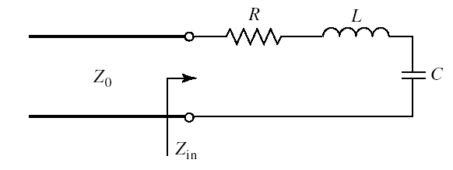
§6.5 Excitation of resonators
1. Critical Coupling
To obtain maximum power transfer between a resonator and a feedline, the resonator must be matched to the feed at the resonant frequency. The resonator is then said to be critically
A series resonant circuit coupled to a feedline.

Slide 3
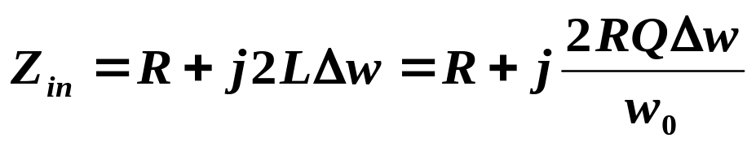
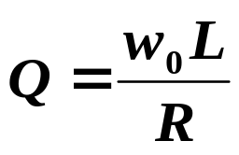


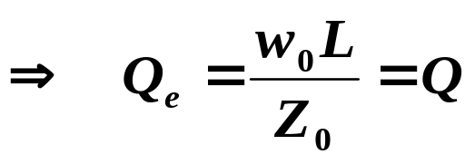
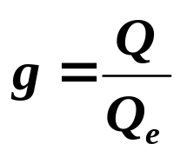
§6.5 Excitation of resonators
In order to match the resonator to the line
define a coefficient of coupling, g , as
(1) g<1 the resonator is said to be undercoupled to the feedline
(2) g=1 the resonator is cirtically coupled to the feedline
(3) g>1 the resonator is said to be overcoupled to the feedline

Slide 4
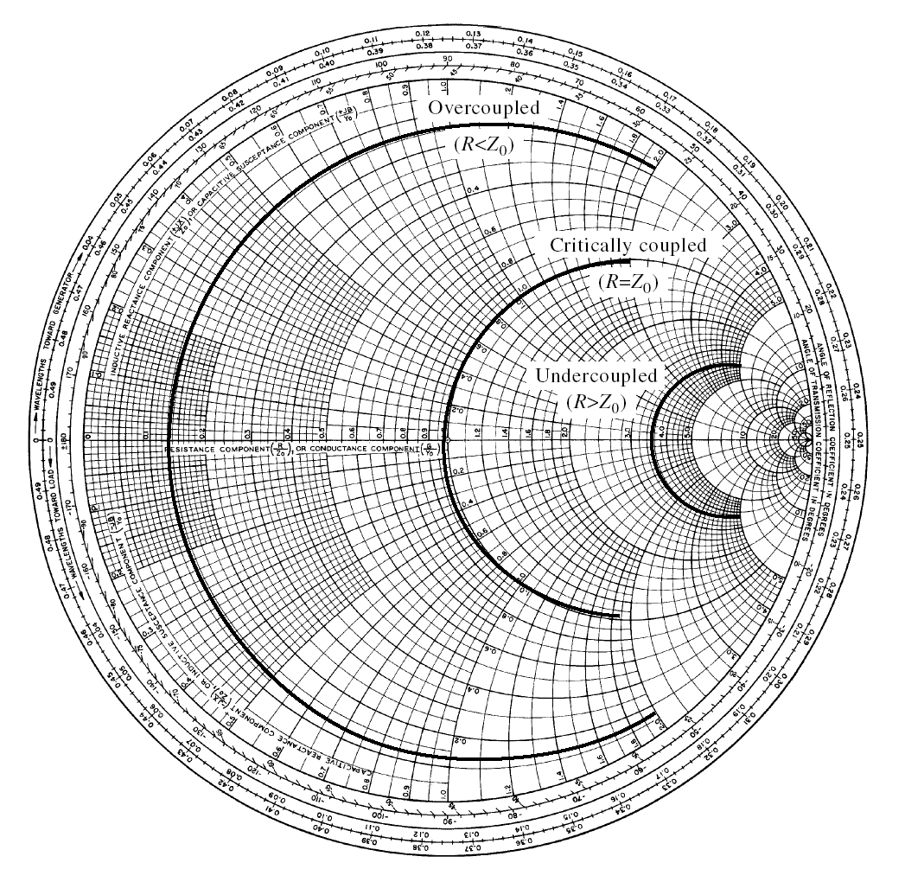
§6.5 Excitation of resonators
a Smith chart sketch of the impedance loci for the series resonant circuit for various values of R corresponding to the above cases.

Slide 5
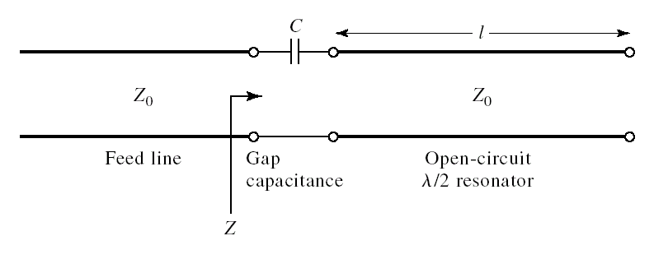
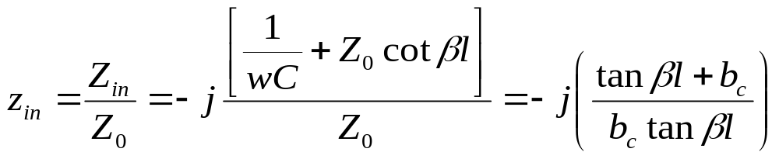

§6.5 Excitation of resonators
2. A Gap-Coupled Microstrip Resonator
Consider a λ/2 open-circuited microstrip resonator coupled to a microstrip feedline

Slide 6
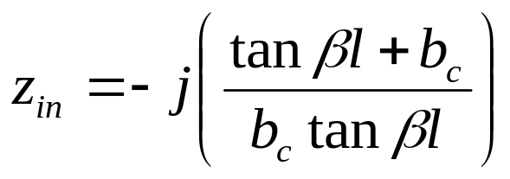
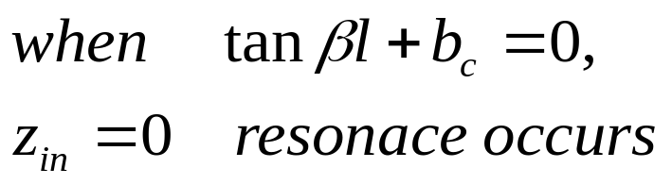
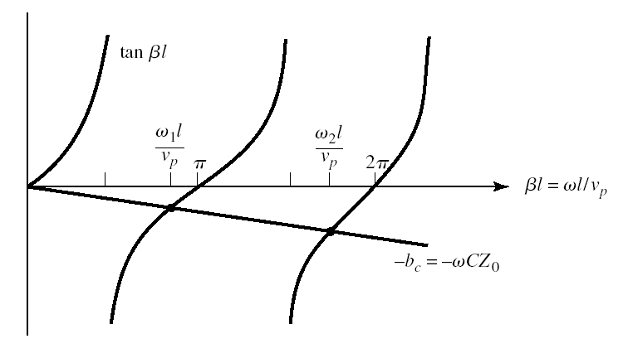
§6.5 Excitation of resonators
Solutions for the resonant frequencies of the gap-coupled microstrip resonator

Slide 7
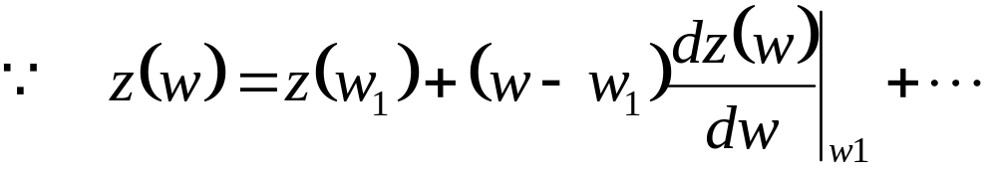

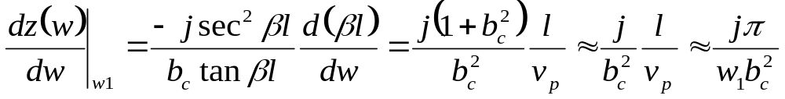
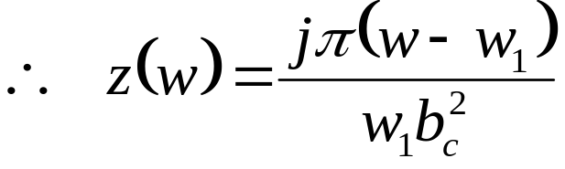

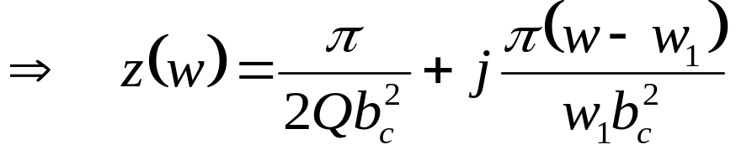
§6.5 Excitation of resonators
For a high Q cavity loss can be included by replacing the w1 with the complex resonant frequency given by

Slide 8
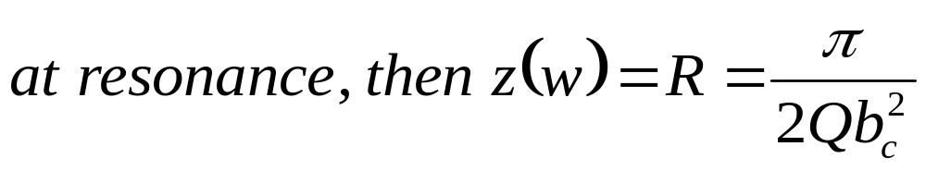
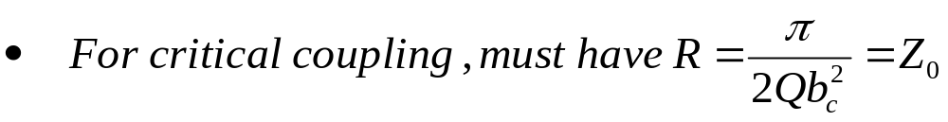
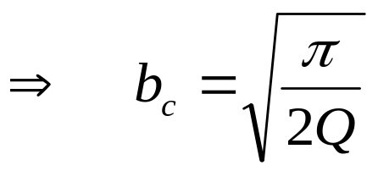
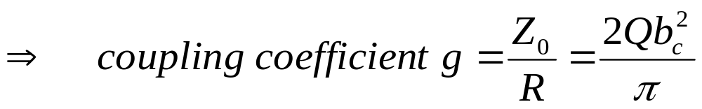
§6.5 Excitation of resonators

Slide 9
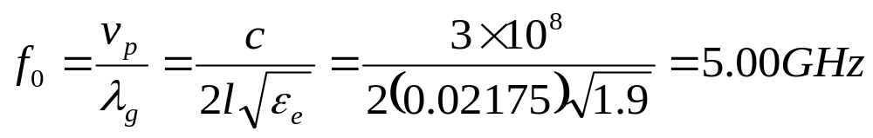
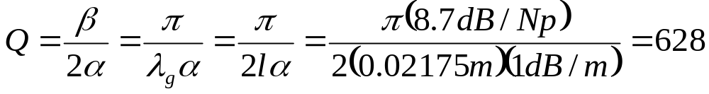
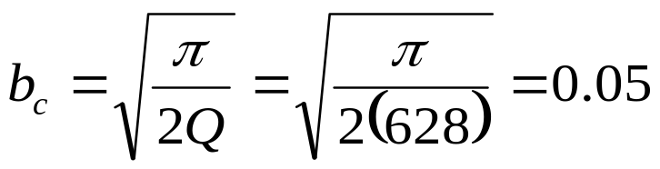
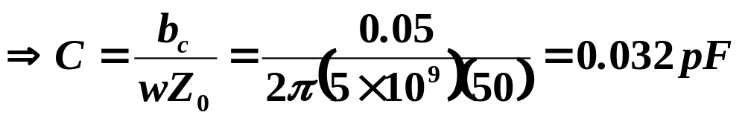
§6.5 Excitation of resonators
Example: Design of a gap-coupled microstrip resonator
A resonator is made from an open-circuited 50Ω microstrip line, and is gap coupled to a 50 Ω feedline. The resonator has a length of 2.175cm, an effective dielectric constant of 1.9 and an attenuation of 0.01dB/cm near its resonance. Find the valued of the coupling capacitor required for critical coupling, and the resulting resonant frequency
Solution:
The first resonant frequency will occur when the resonator is about l=λg/2

Slide 10
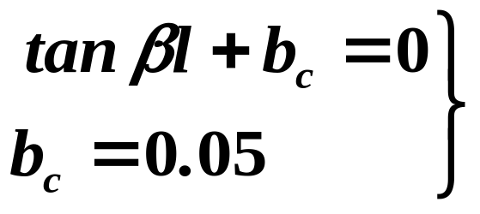
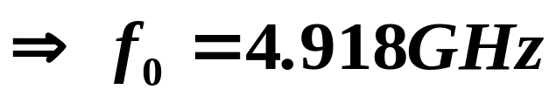
§6.5 Excitation of resonators

Slide 11
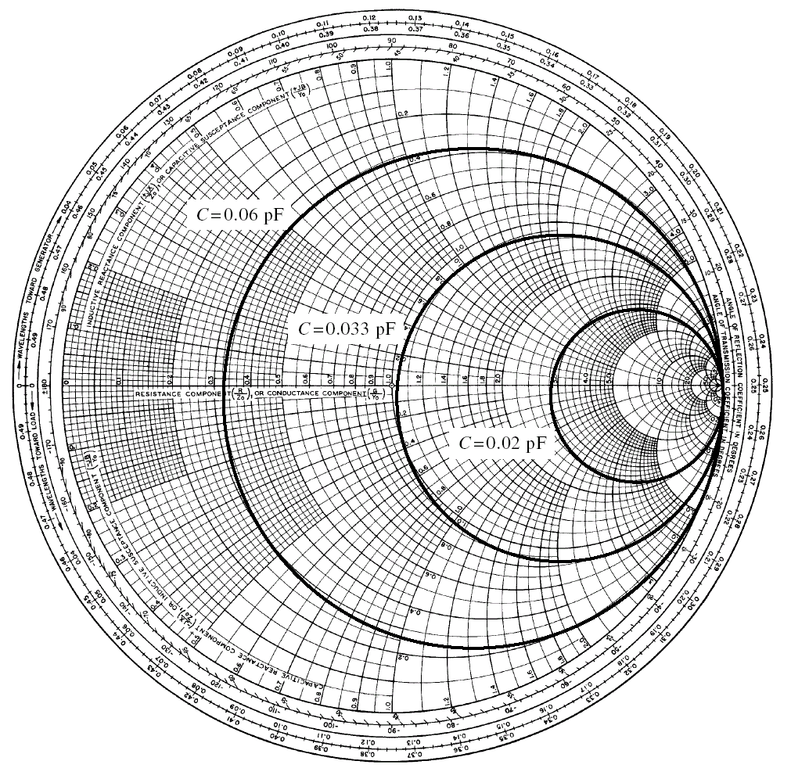
Smith chart plot of Zin of the gap-coupled microstrip resonator versus frequency for various values of the coupling capacitor.

Slide 12
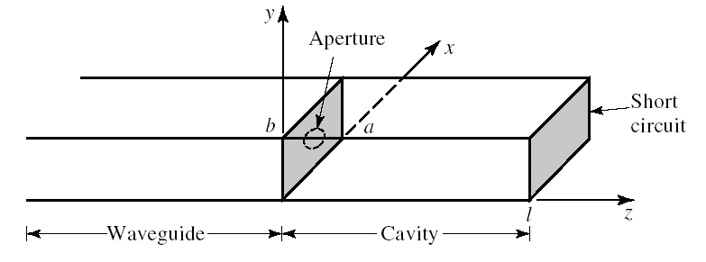
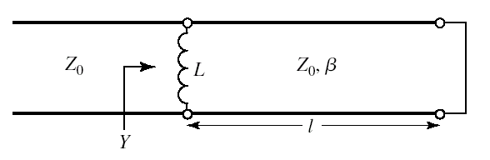
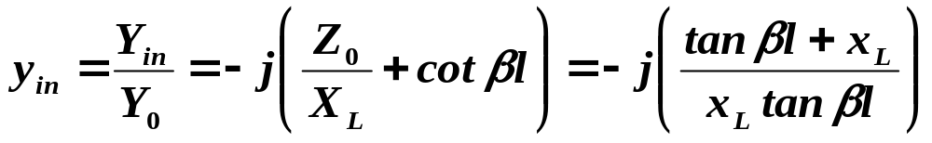

§6.5 Excitation of resonators
3. An Aperture-Coupled Cavity
Consider the aperture coupled waveguide cavity

Slide 13
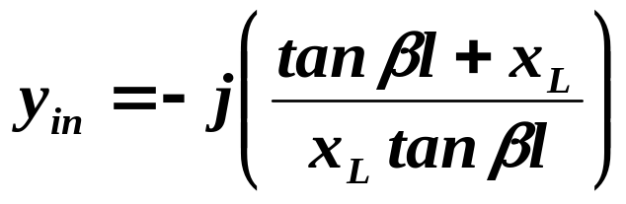
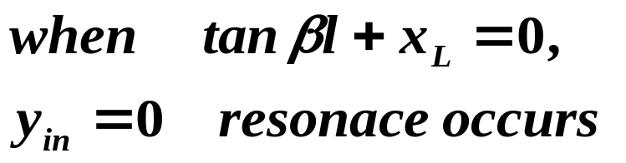
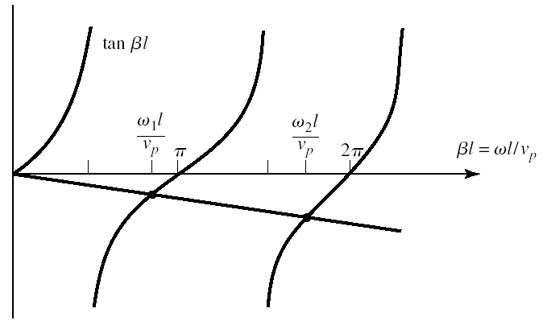
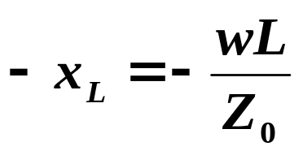
§6.5 Excitation of resonators

Slide 14
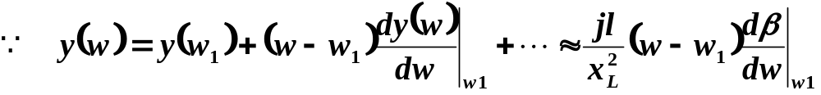

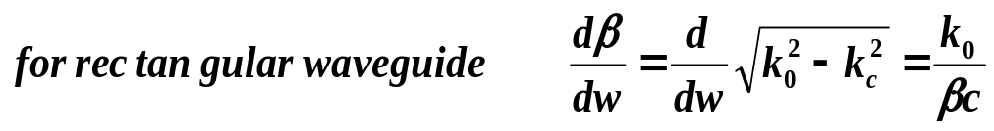
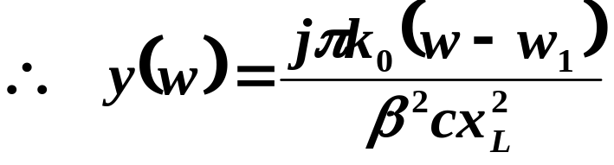

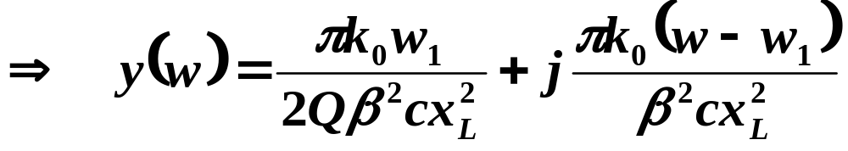
§6.5 Excitation of resonators
For a high Q cavity loss can be included by replacing the w1 with the complex resonant frequency given by

Slide 15
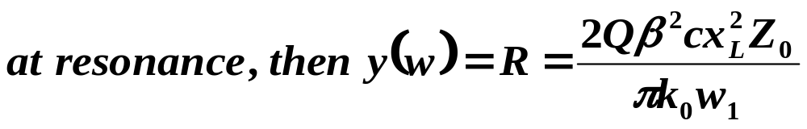
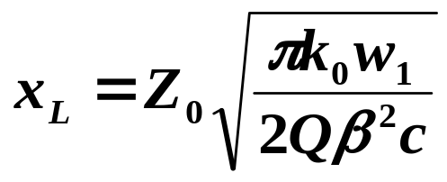
§6.5 Excitation of resonators
From x_{L} , the necessary aperture size can be found

Slide 16
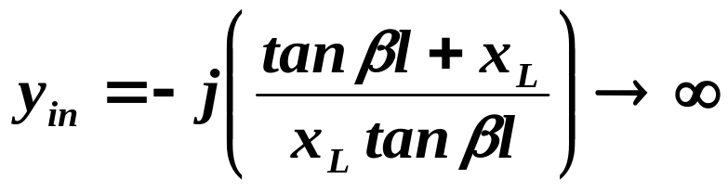

§6.5 Excitation of resonators
the next resonant mode occurs when Zin=0 or Yin → ∞
In this case, the cavity is exactly λ_{g}/2 long
So a null in the transverse electric field exists at the aperture plane, and the aperture has no effect.

